Slide 1
Introduction

Slide 2
Contents
Java in the modern era
Tooling
JShell

Slide 3
1. Java in the Modern Era
Java releases since Day One
All change
Managing change
How new features are introduced

Slide 4
Java Releases Since Day One
Up to and including Java 8, new major releases came along at fairly lengthy (and ad-hoc) intervals
JDK 1.0 January 1996
JDK 1.1 February 1997
J2SE 1.2 December 1998
J2SE 1.3 May 2000
J2SE 1.4 February 2002
J2SE 5.0 September 2004
Java SE 6 December 2006
Java SE 7 July 2011
Java SE 8 March 2014
Each version has seen multiple updates, some of which have introduced major new features
E.g. Java 8u20, Java 8u40, etc.
Notes:
Java 9 packs quite a punch. For a summary of the new features, see:
https://docs.oracle.com/javase/9/whatsnew/toc.htm#JSNEW-GUID-C23AFD78-C777-460B-8ACE-58BE5EA681F6
The next few slides describe some of the key features.

Slide 5
All Change
Java 8 was the last version that will be released in this fashion
From Java 9 onwards, Oracle increased the release cadence of Java SE to every six months
New features can be delivered in a timelier manner, rather than having to wait years for a "major release"
Other vendors/libraries doing similarly (e.g. Angular, Eclipse, …)
Java 17 is the most recent incarnation (Sept 2021)
Java 17 is LTS, as were Java 11 and Java 8
Oracle intends to make future LTS releases every 2 years
The next planned LTS release is Java 21 (scheduled for Sept 2023)
Notes:
The setup document for this course includes Java 9 (as well as Java 8). The slide above describes how to set up your environment to use the Java 9 JDK and JVM.

Slide 6
Managing Change
How can we adopt major releases every 6 months?!?!!
There won't be "major releases" any more
Instead we'll have a steady stream of "feature releases"
For example, going from Java 9->10->11…
This is more like going from Java 8->8u20->8u40
Than it is like going from Java 6->7->8
Recommended practice:
Stick to the LTS versions, e.g. Java 17
Notes:
Java 9 features a new command line tool called jshell that adds native support and popularizes a Java way to REPL (Read-Eval-Print-Loop).
This means you can run Java statements on their own, directly in a REPL shell, without having to wrap up the code in a project or method.

Slide 7
How New Features are Introduced
Preview Features
A brand new feature in the language or VM in the Java SE Platform
Fully specified, fully implemented, but impermanent
The idea is to provoke developer feedback, like a beta test
To use, you must set the -enable-preview compiler flag
Experimental Features
Early versions of (mostly) VM-level features, e.g. GC alg
Risky, incomplete, or even unstable
To use, you must typically set dedicated flags
Incubating Features
Experimental APIs, distributed in separate modules with names prefixed with jdk.incubator.
To use, you must explicitly add the incubator module
Notes:
Java 9 features a new command line tool called jshell that adds native support and popularizes a Java way to REPL (Read-Eval-Print-Loop).
This means you can run Java statements on their own, directly in a REPL shell, without having to wrap up the code in a project or method.

Slide 8
2. Tooling
Oracle JDK vs. OpenJDK
Getting OpenJDK
Tool support

Slide 9
Oracle JDK vs. OpenJDK
Oracle have stopped releasing its JDK for free
Java 10.0.2 (July 2022) will be the last free Oracle JDK
Java 11+ will be free to use in dev/test, but not in prod
For pricing info, see here:
www.oracle.com/us/corporate/pricing/technology-price-list-070617.pdf
Alternatively you can use OpenJDK for free
Open-source implementation of the Java SE
Licensed under GNU General Public License (GNU GPL) version 2
The official reference implementation of Java SE since version 7

Slide 10
Getting OpenJDK
You can get OpenJDK versions from here:
http://jdk.java.net/xx
For example, to get OpenJDK 11 (GA since 25 Sept 2022)
http://jdk.java.net/17/
The JDK is available as a simple archive file
E.g. a tar file for Linux/macOS, extract as follows:
E.g. a zip file for Windows, extract as follows:
tar xvf openjdk-17*_bin.tar.gz
unzip openjdk-17*_bin.zip
Notes:
Modular development is one of the most important new features in Java 9. We'll explain what modules are, how to define modules, how to export packages from a module, and how to indicate dependencies between modules.

Slide 11
Tool Support
Tool vendors (and platform providers) found the transition to the six-monthly cadence quite challenging initially
The story has settled somewhat now
Vendors and providers have gotten used to the idea and have been able to plan properly for upcoming releases
For Example:
IntelliJ supports Java 17 👍
Notes:
A module is specified by a special file named module-info.java. This file specifies three pieces of information about the module:
The name of the module. This name should follow a pattern such as com.mydomain.mybizmodule, to avoid conflicts.
A list of all the packages that this module exports, i.e. the packages that can be considered as the public API of this module, such that they can be accessed by other modules. (If a class is not in an exported package, no one outside of your module can access it – even if it is public).
A list of other modules that this module depends on (the Java 9 documentation uses the phrase "reading another module"). All public types that those modules export are accessible by the module in question.
Note:
The Java SE library has been refactored into modules in Java 9. For details, see:
http://openjdk.java.net/projects/jigsaw/

Slide 12
3. JShell
Overview of JShell
Defining and calling methods
Defining and using classes
JShell commands
Using an editor
Specifying a class path
Specifying a module path
Aside: Running a Java file directly
Notes:
In this section we summarize some of the key features in Java 9. This is not meant to be a comprehensive survey of Java 9!

Slide 13
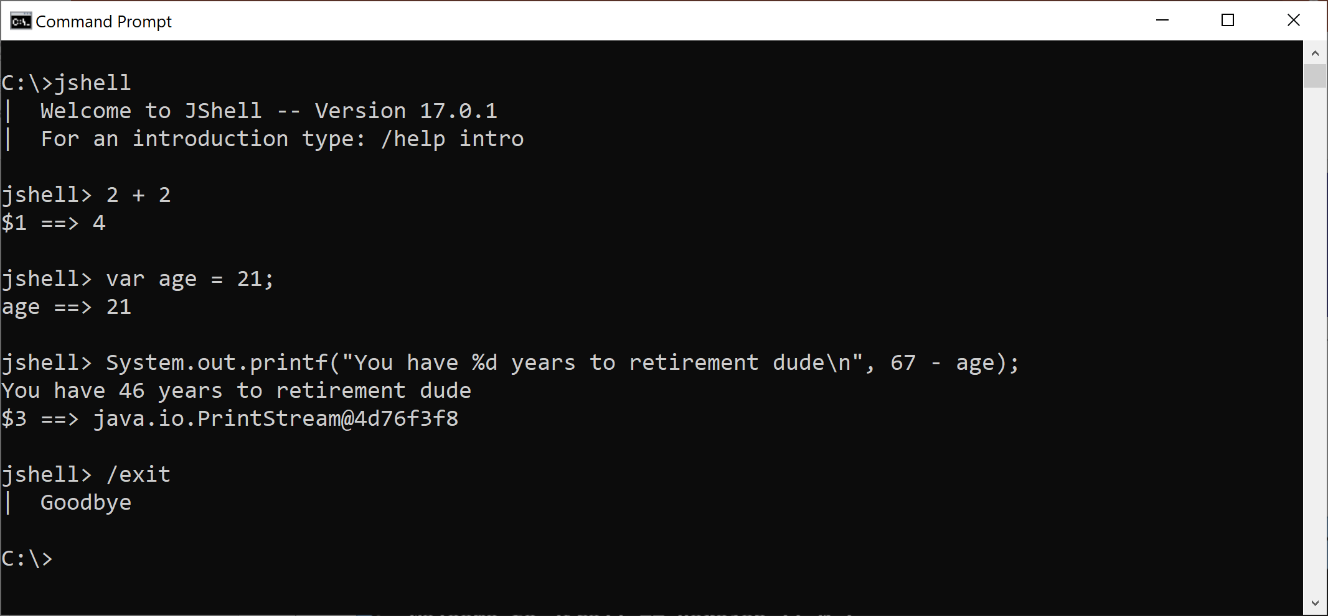
Overview of JShell
Java 9 introduced JShell, a REPL that allows you to enter Java statements and expressions directly
Run jshell
Notes:
Java 9 features a new command line tool called jshell that adds native support and popularizes a Java way to REPL (Read-Eval-Print-Loop).
This means you can run Java statements on their own, directly in a REPL shell, without having to wrap up the code in a project or method.

Slide 14
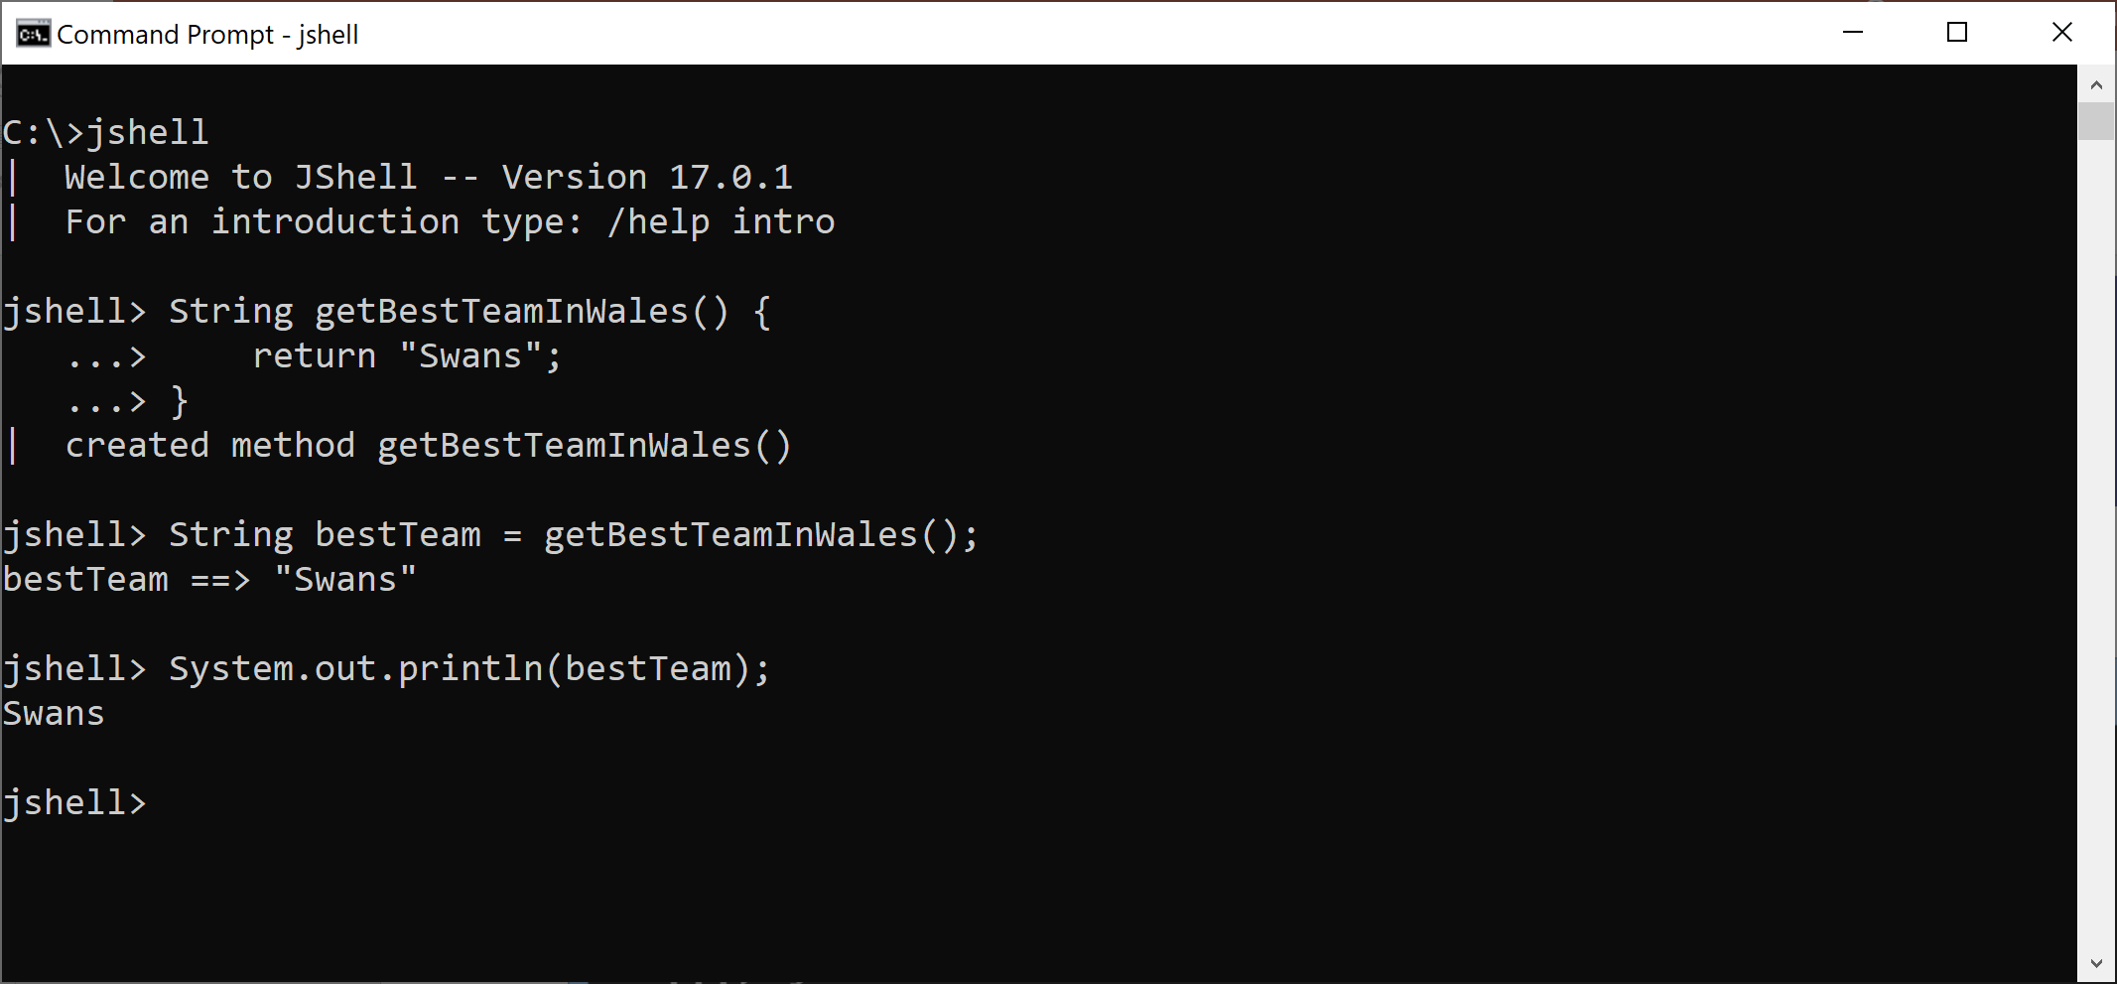
Defining and Calling Methods
You can define and call methods
Notes:
Java 9 features a new command line tool called jshell that adds native support and popularizes a Java way to REPL (Read-Eval-Print-Loop).
This means you can run Java statements on their own, directly in a REPL shell, without having to wrap up the code in a project or method.

Slide 15
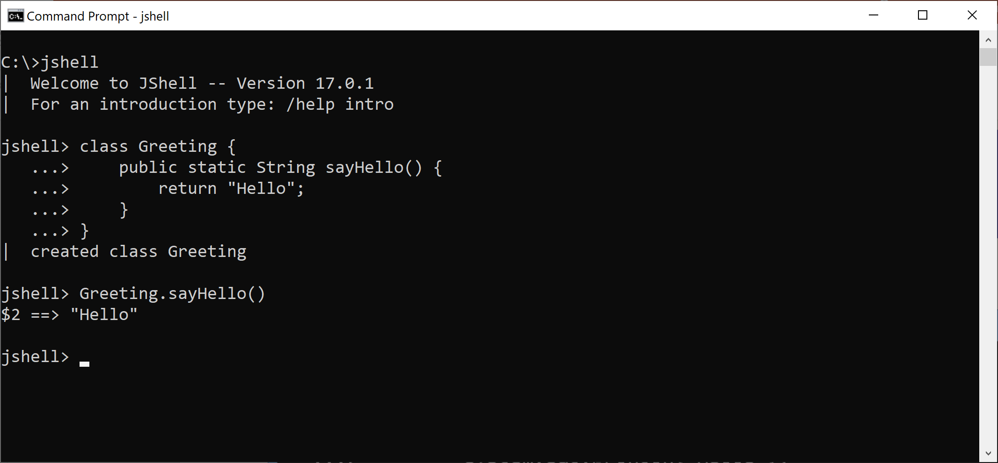
Defining and Using Classes
You can define and use classes
You can press TAB to get IntelliSense
Notes:
Java 9 features a new command line tool called jshell that adds native support and popularizes a Java way to REPL (Read-Eval-Print-Loop).
This means you can run Java statements on their own, directly in a REPL shell, without having to wrap up the code in a project or method.

Slide 16
JShell Commands
JShell supports various commands, including:
/imports
/types
/methods
/vars
/list
/list -all
Try them out ☺
Notes:
Java 9 features a new command line tool called jshell that adds native support and popularizes a Java way to REPL (Read-Eval-Print-Loop).
This means you can run Java statements on their own, directly in a REPL shell, without having to wrap up the code in a project or method.

Slide 17
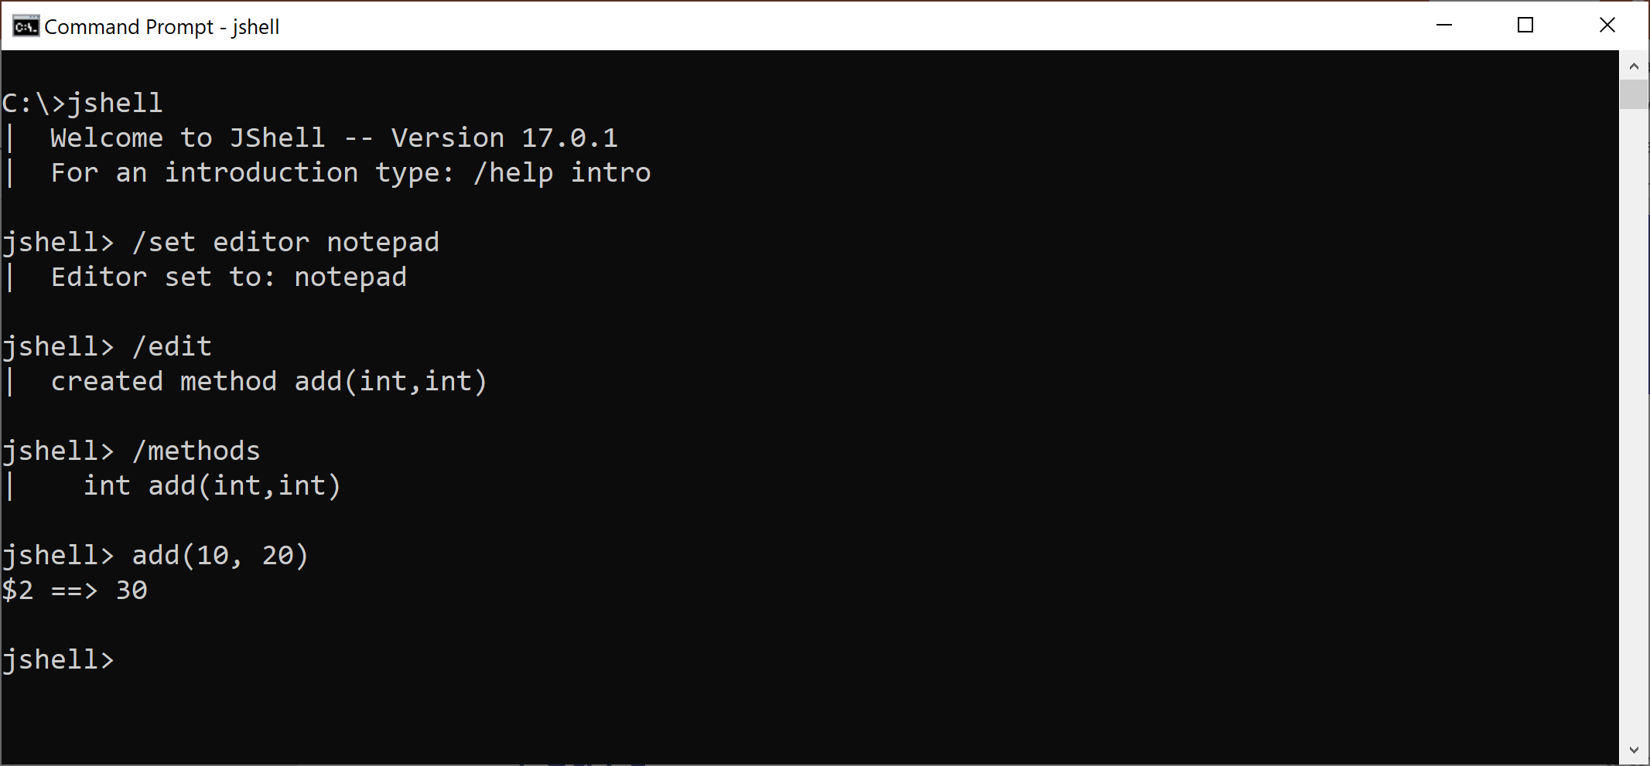
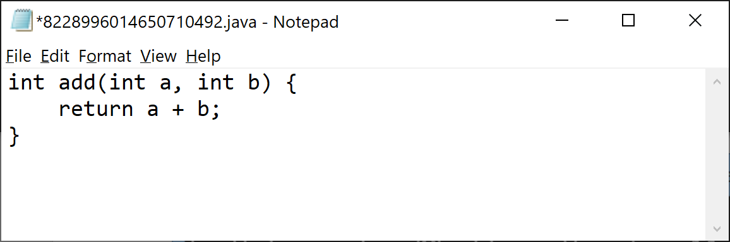
Using an Editor
You can tell JShell to support an editor
/set editor notepad
You can then start an editing session as follows
/edit
Save file
Notes:
Java 9 features a new command line tool called jshell that adds native support and popularizes a Java way to REPL (Read-Eval-Print-Loop).
This means you can run Java statements on their own, directly in a REPL shell, without having to wrap up the code in a project or method.

Slide 18
Specifying a Class Path
When you run JShell, you can specify a class path
jshell --class-path myClassPath
Within JShell, you can use the /env command to set the class path
/env --class-path myOwnClassPath
Notes:
Java 9 features a new command line tool called jshell that adds native support and popularizes a Java way to REPL (Read-Eval-Print-Loop).
This means you can run Java statements on their own, directly in a REPL shell, without having to wrap up the code in a project or method.

Slide 19
Specifying a Module Path
Java 9+ supports modules
See later in the course details
When you run JShell, you can specify module-related properties
jshell --module-path myModulePath --add-modules com.osl.myModule
Within JShell, you can use the /env command to set module-related properties
/env --module-path myModulePath --add-modules com.osl.myModule
Notes:
Java 9 features a new command line tool called jshell that adds native support and popularizes a Java way to REPL (Read-Eval-Print-Loop).
This means you can run Java statements on their own, directly in a REPL shell, without having to wrap up the code in a project or method.

Slide 20
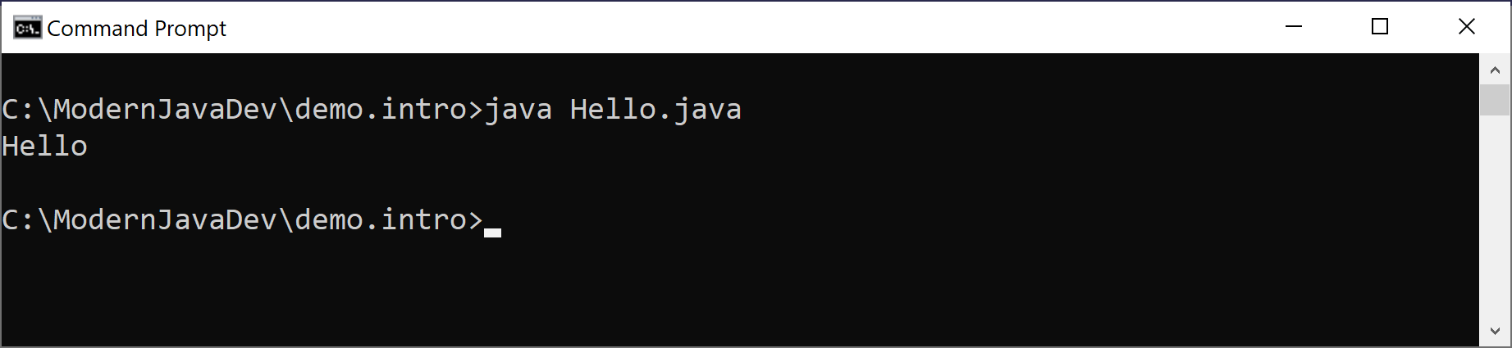
Aside: Running a Java File Directly
Java 11 introduced the ability to run a single-file Java program directly
Just compile + run, in 1 step
Example:
public class Hello {
public static void main(String[] args) {
System.out.println("Hello");
}
}
demo.intro/Hello.java
Notes:
Java 9 features a new command line tool called jshell that adds native support and popularizes a Java way to REPL (Read-Eval-Print-Loop).
This means you can run Java statements on their own, directly in a REPL shell, without having to wrap up the code in a project or method.

Slide 21
Any Questions?

